Slide 1
FWD Project
TOGAF 9 - Core Diagrams Application Communication Diagram Phase C – Information Systems Architectures

Slide 2
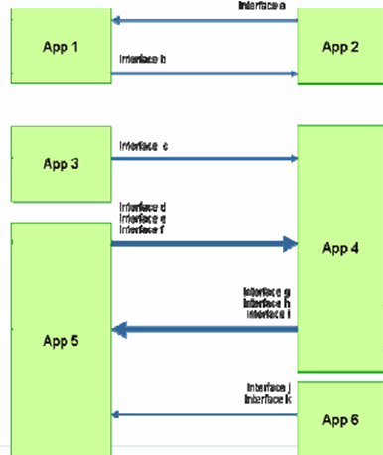
Application Communication Diagram

Slide 3
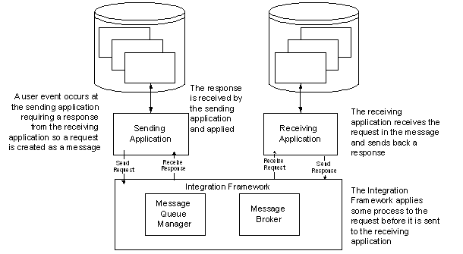
Application Communication Diagram

Slide 4
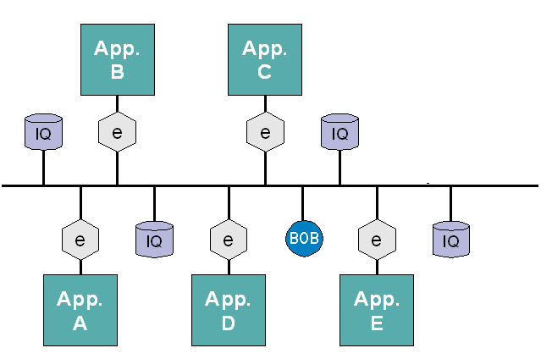
Application Communication Diagram

